Slide 1
Decoding Bitcoin's Future: A Classification Approach to Price Prediction
Group #1: Jake Schuler, Praveen Rajendran Nair, Rakshit Vastrad,
CJ

Slide 2


Problem Statement
“Addressing the challenge of Bitcoin's volatile market, this project aims to predict its price fluctuations through a classification-based approach, utilizing sophisticated data cleaning and time series analysis.”

Slide 3
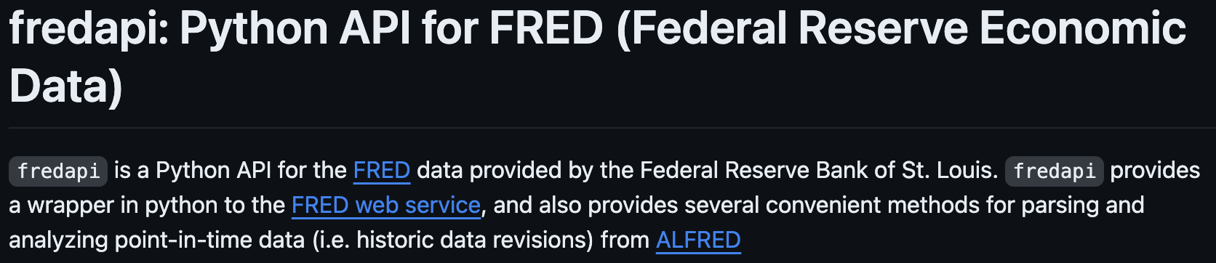
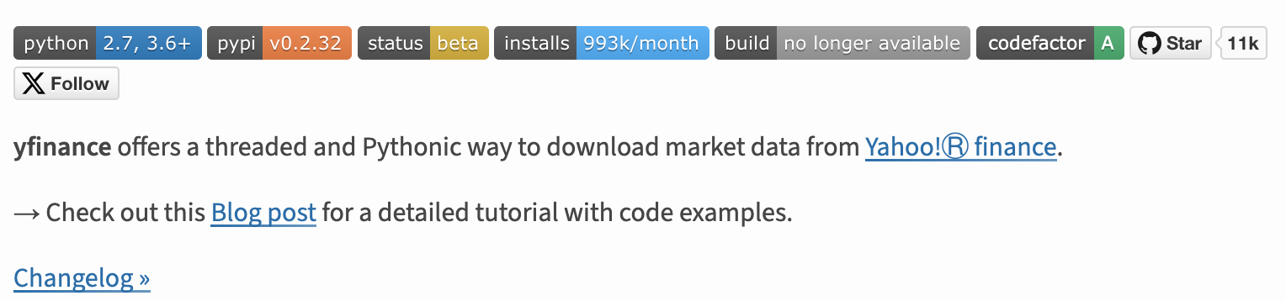
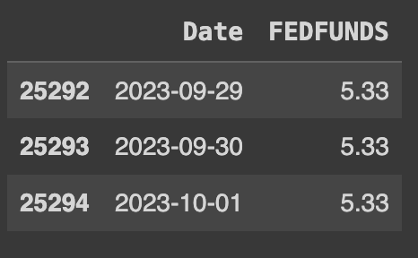
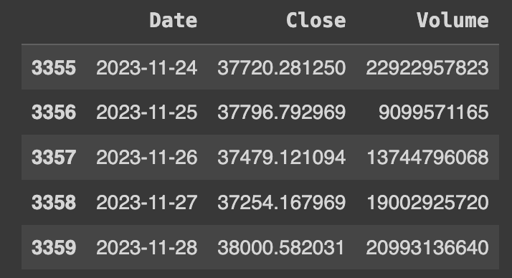
Gathering Data for Bitcoin Price Prediction
Key APIs: Federal Funds Rate from FRED API & historical price data from yFinance API
Example frame:
Example frame:

Slide 4
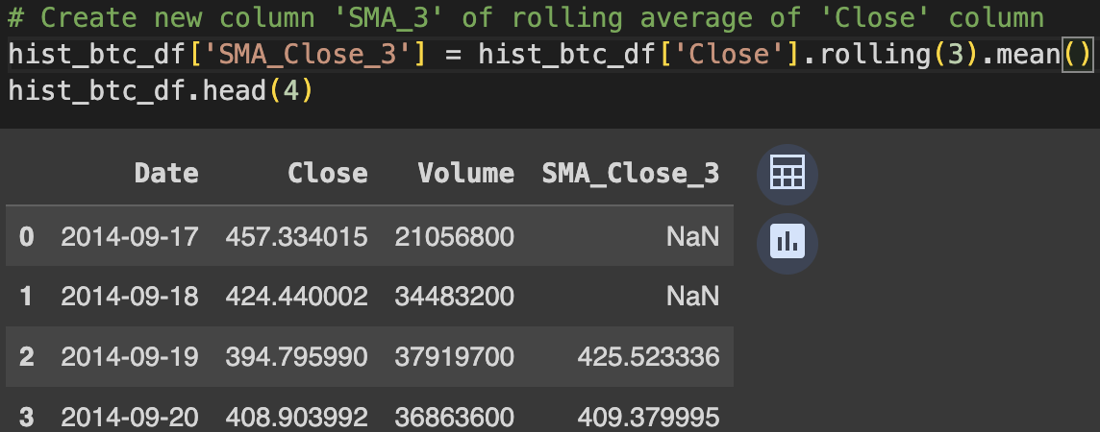
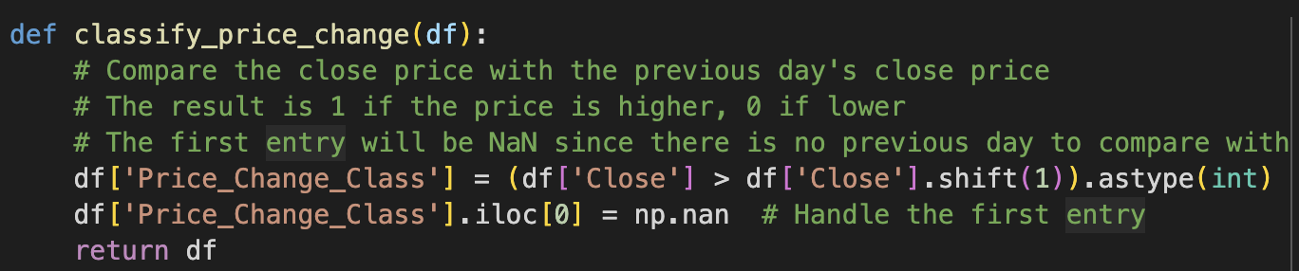
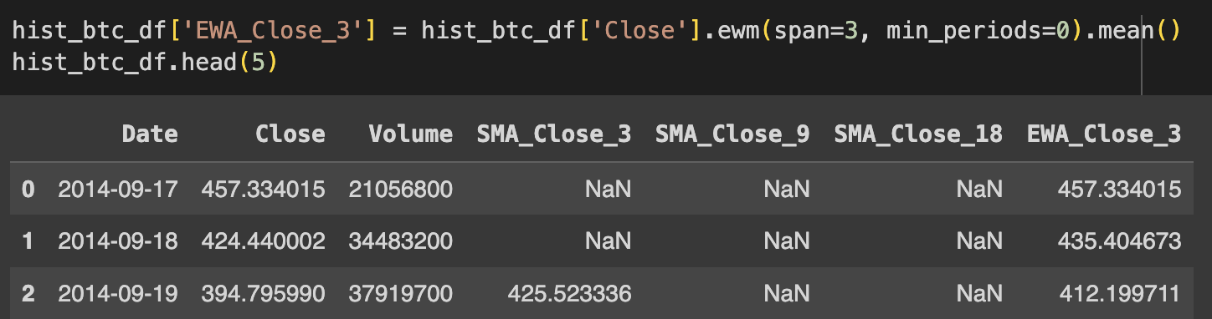
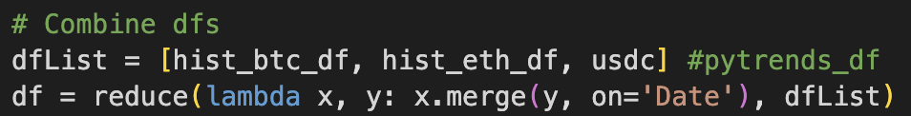
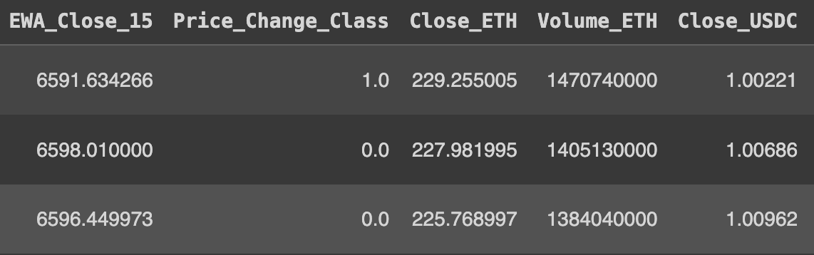
Refining the Data: Applying SMA and EMA in Bitcoin Price Analysis
Examples of new feature creation:
Creating the classification (1 for higher, 0 for lower) on ‘Close’ column
Adding in other currencies
*Final Dataset has 5 different operations on Close

Slide 5

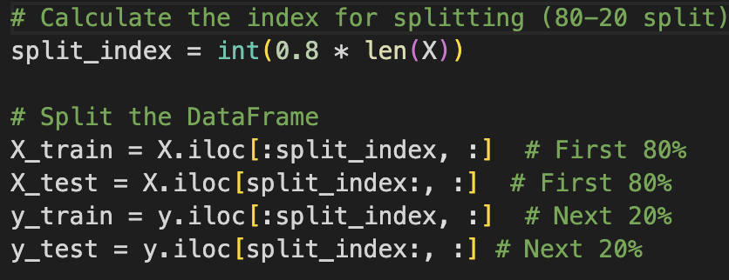


Chronological Clarity: Sorting Data by Date for Effective Time Series Analysis
Sorting the data on date
80 / 20 split. Cannot use sklearn due to randomness

Slide 6


Model 1: Random Forest Classifier
Why Random Forest?
Ensemble Learning Method
Effective at handling non-linear relationships
Less likely to overfit
Handle Large datasets
Notes:
Random Forest is a strong candidate for Bitcoin price prediction due to its ability to handle complex and non-linear data patterns, typical in cryptocurrency markets. Its ensemble nature, which aggregates decisions from multiple decision trees, helps in reducing overfitting, ensuring more reliable predictions. Additionally, it can efficiently process large datasets with various features and is relatively robust against missing or unstructured data, making it well-suited for the dynamic and often incomplete nature of financial data.

Slide 7
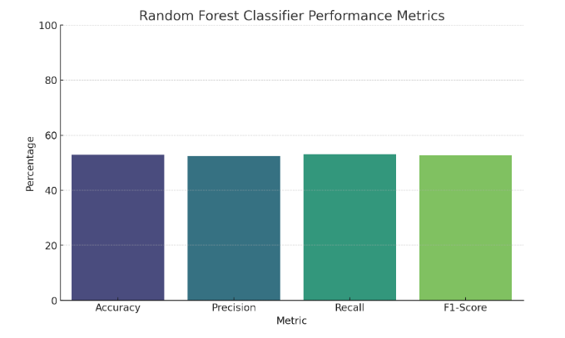
Model 1: Random Forest Classifier - Results
Performance Metrics:
Visual representation of Accuracy, Precision, Recall, F1-Score.
Interpretation:
Moderate accuracy, indicating slightly better performance than random guessing.
A balance in Precision and Recall, but overall room for improvement.

Slide 8


SVM Model
Effective in High-Dimensional Spaces: SVMs perform well in high-dimensional spaces, which is important when dealing with financial data like Bitcoin prices that may involve multiple features.
Handles Non-Linearity: SVMs can effectively handle non-linear relationships in data through the use of kernel functions. This is crucial in capturing complex patterns and relationships in Bitcoin price movements.
Global Optimization: SVMs aim to find a global optimum, providing a robust solution for capturing trends in the data. This is important in financial forecasting where global patterns may be more critical than local fluctuations.

Slide 9
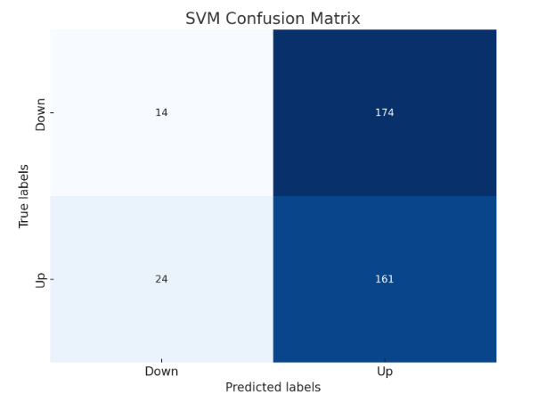
Model 2-SVM results
Confusion Matrix Overview:
Interpretation:
The model shows a bias towards predicting uptrends (high True Positive rate).
Challenges in accurately predicting downtrends (high False Positive rate).
SVM Model Metrics:
Accuracy: ~46.9%.
Precision, Recall, F1-Score for 'Down' and 'Up' trends.
Analysis:
Lower accuracy compared to the Random Forest model.
Precision and Recall trade-off evident, with higher recall for uptrends.

Slide 10

Model 3-Gradient Boosted Classifier
Initial Training with GBM:
Trained using GradientBoostingClassifier with default parameters.
Dataset involved Bitcoin, Ethereum, and USDC related financial indicators.
Preprocessing included imputation, feature selection, data splitting, and standardization.
Hyperparameter Tuning:
Tuning executed using GridSearchCV.
Parameters adjusted: n_estimators, learning_rate, max_depth, min_samples_split, min_samples_leaf, subsample.
Best parameters found: learning_rate = 0.2, max_depth = 3, etc.

Slide 11
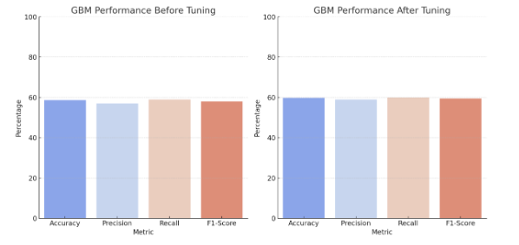
Model 3-GBM
Performance Metrics Comparison:
Before Tuning: Accuracy = 58.7%, Precision ≈ 57%, Recall ≈ 59%, F1-Score ≈ 58%.
After Tuning: Accuracy = 59.8%, Precision ≈ 59%, Recall ≈ 60%, F1-Score ≈ 59.5%.
Interpretation of Results:
Notable improvement in accuracy and other metrics post-tuning.
Demonstrates the impact of optimal hyperparameter settings.
Enhanced model's predictive ability, particularly in forecasting Bitcoin price movements.

Slide 12

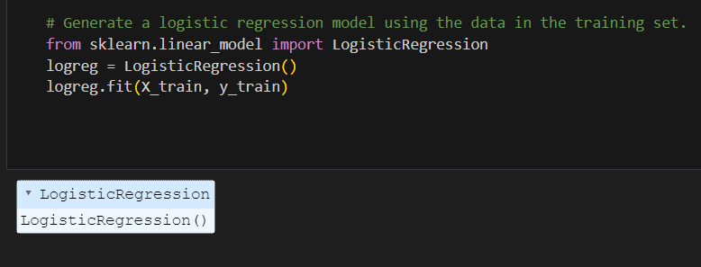
Model 4 - Logistic Regression
Aim : Explain Logistic Regression and its use to predict whether the price of crypto is going up or down the next day, based on the various independent variables.
Relevance: Application in price fluctuation prediction

Slide 13
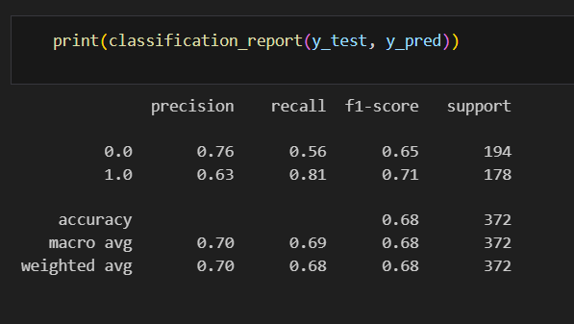
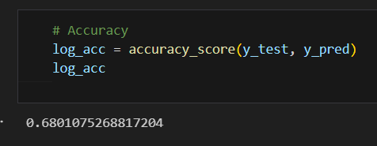
Why Logistic Regression - Results
Classification Problem - Logistic Regression Good Place to Start
Confusion Matrix and Classification Report: Display the provided results.
Accuracy Score: 0.680

Slide 14

Model 5 - Why LSTM
Suited for sequential data handling.
Bitcoin prices exhibit temporal dependencies, meaning that current prices are often influenced by past prices.
Consist of memory cells, which allow the network to remember information.
Suited to pick up non-linear patterns.

Slide 15
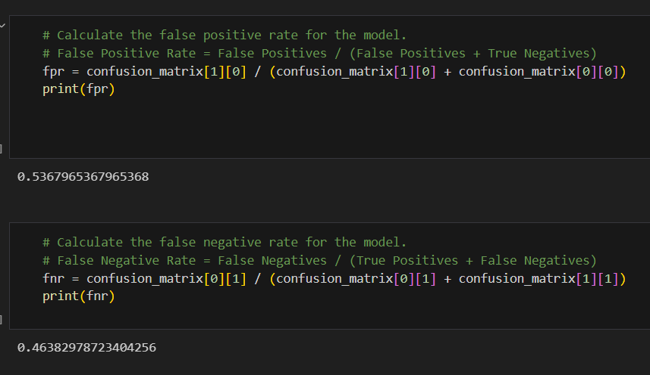
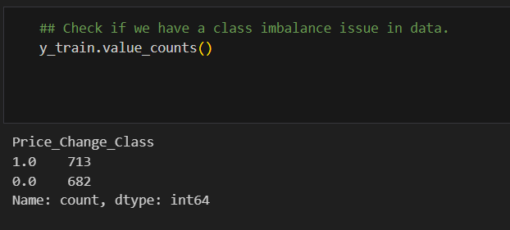
Challenges Faced
False Positive Rate and False Negative Rate
No Balancing required because balanced data.
Different Train - Test Split Gave Different Results

Slide 16
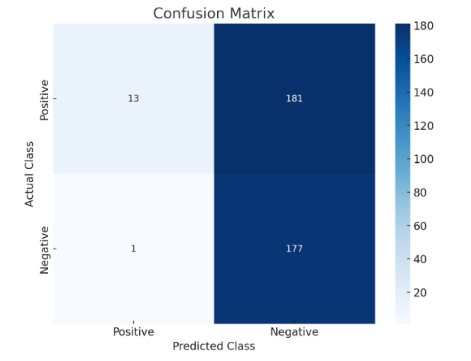
Model 5 - LSTM
Accuracy Score - 0.5107
Confusion Matrix
[[ 13 181]
[ 1 177]]
Insufficient Data
External factors - Financial markets are influenced by external factors that cannot be captured effectively by ML models.

Slide 17

Why Naive Bayes Model?
Simple and Efficient
Handling of Conditional Independence
Probabilistic Nature
Good Performance with Small Datasets
Fast for Real-time Prediction
Handling of Non-linear Relationships
Robustness to Noise
Notes:
Simple and Efficient: Naive Bayes models are known for their simplicity and efficiency. They require a small amount of training data to estimate the necessary parameters, making them suitable for scenarios where historical data might be limited or not extremely diverse.
Handling of Conditional Independence: These models assume that the features used to predict the target variable are conditionally independent given the target. This assumption, while simplistic, can be quite effective in practice, especially in complex domains like financial markets where the relationships between variables are not always clear or linear.
Probabilistic Nature: Naive Bayes is fundamentally a probabilistic classifier, meaning it can provide not just predictions, but also the degree of certainty about the prediction. This is particularly useful in financial contexts like Bitcoin trading, where understanding the uncertainty of a prediction is as important as the prediction itself.
Good Performance with Small Datasets: Naive Bayes models can perform well even with a small amount of data, unlike more complex models that might require large datasets to avoid overfitting.
Fast for Real-time Prediction: Due to their simplicity, these models are fast to train and make predictions. This is crucial for Bitcoin trading, where the market conditions change rapidly, and timely decisions are vital.
Handling of Non-linear Relationships: Financial markets data often contains non-linear relationships, which Naive Bayes can handle reasonably well, given its non-parametric nature.
Robustness to Noise: Naive Bayes classifiers can be quite robust to irrelevant or noisy features, which is beneficial given the volatile and sometimes chaotic nature of Bitcoin price movements.

Slide 18
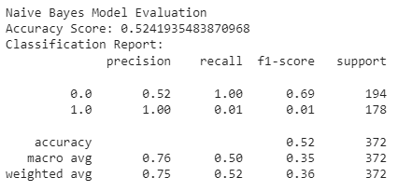
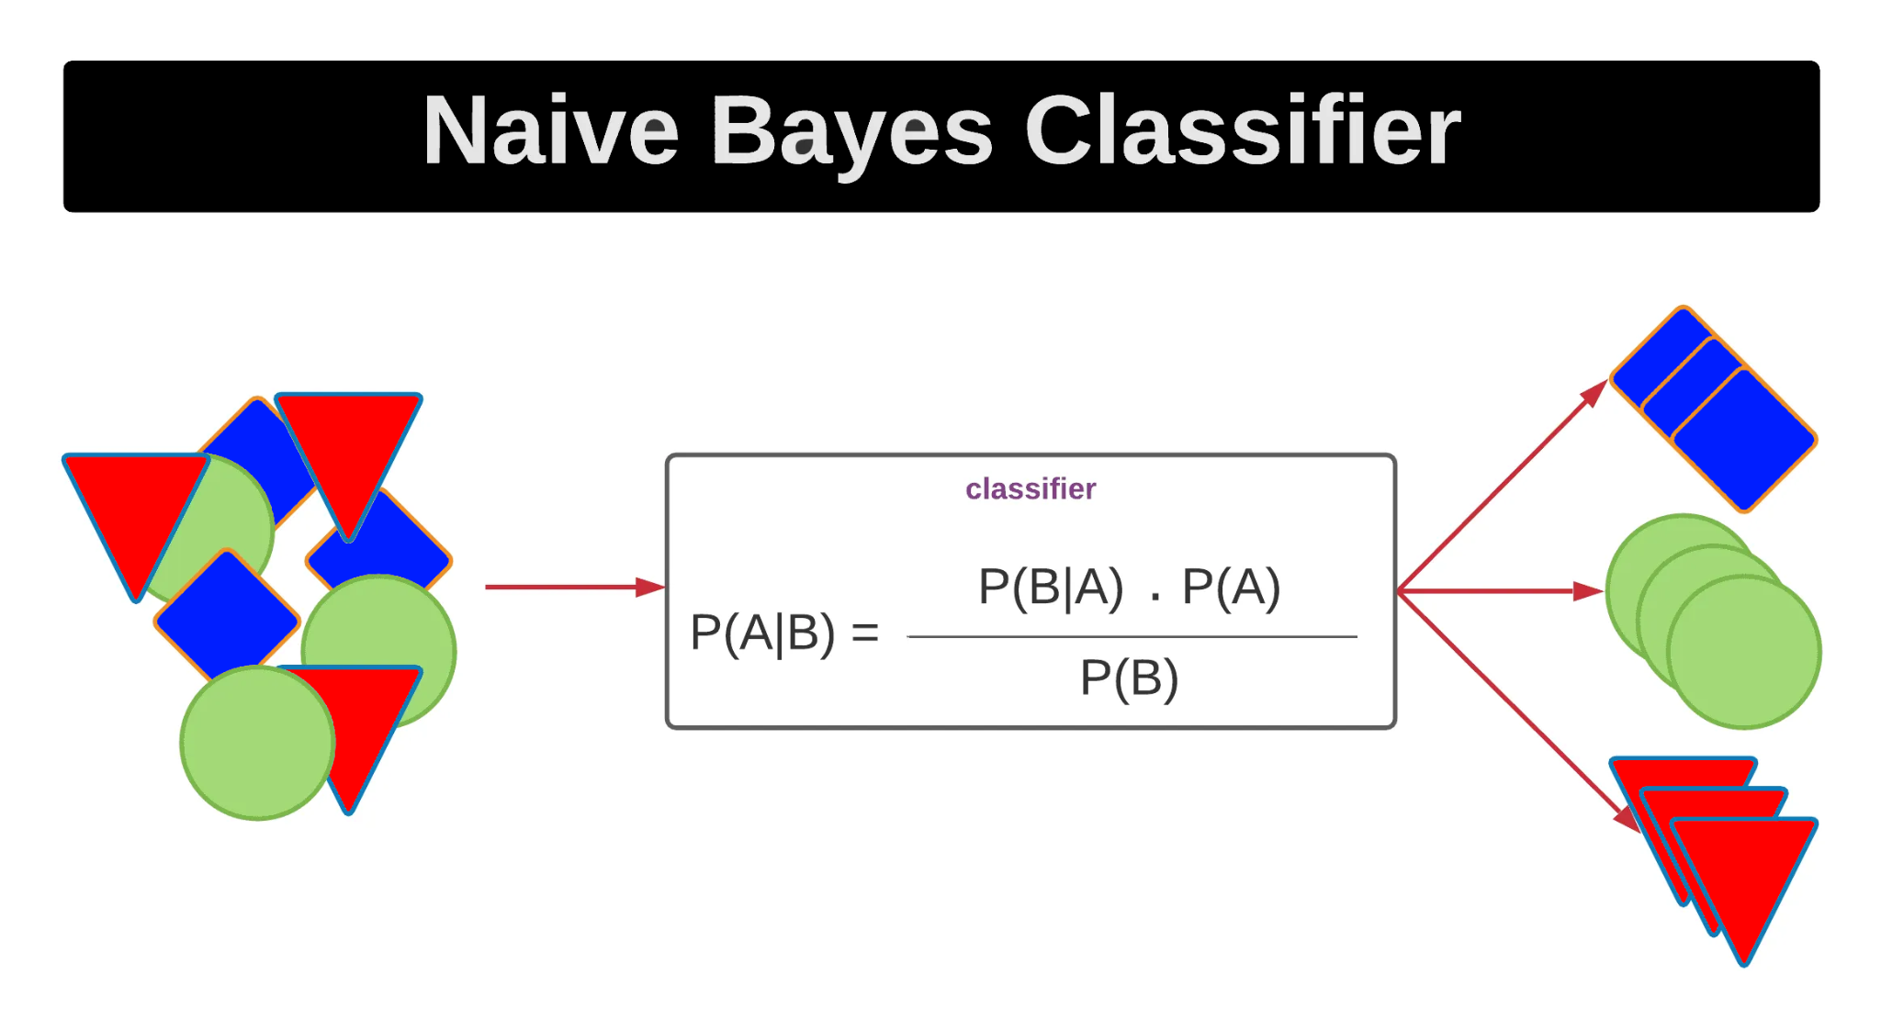
Naive Bayes Model

Slide 19
Comparing Models, why logistic regression?
Linearity - Contrary to expectations it seems that prices do behave more in a linear fashion and so logistic regression was able to capture it better.
Data - For a model like LSTM, data required is much more, logistic regression does better with the limitations of data.
Less Noise - Logistic regression is less prone to problem of overfitting.

Slide 20
Conclusion and Future Directions
Overall, we found that there is potential for using algorithms and prediction models in finance
Crypto 24/7 = Better Data Feed
Sparks of potential, but not able to compete with HFT firms
Recommendations:
Feed in more features and data
Extensive research on how profit model
Setup futures account and test with real money

